Slide 1
Access to social protection
Lucie Davoine
European Commission, DG EMPL
Brussels, 05 March 2019
Notes:
Script to presenter:
Slides 2-3: benefits of social protection
Remaining slides: focus on challenges

Slide 2
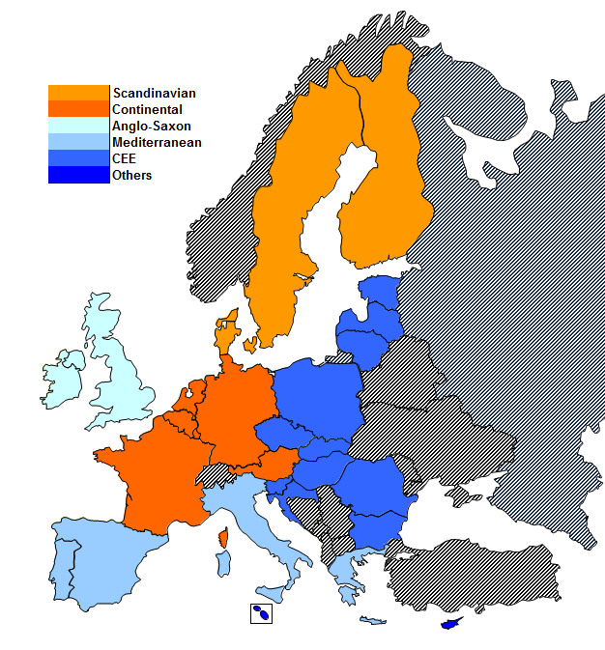
Organisation of Welfare Regimes in the EU
Scandinavian: Comprehensive, universal
Continental: Social insurances based on contribution
Anglo-Saxon: Based essentially on the markets, minimal role of the State
Mediterranean: Based on supportive family networks
CEE: Mix of previous models, depending on the country

Slide 3
1
EU welfare states overall do a good job in reducing inequalities but key challenges ahead
Preserving and improving adequacy and sustainability of welfare states in the face of
Digitalisation and future of work
Population ageing
Globalisation

Slide 4
How does the labour market look today?
Types of employment relationships, EU28, 2016
Source: Eurostat

Slide 5
The at-risk-of-poverty (AROP) and material deprivation rates differ significantly across employment types.
At-risk-of-poverty (AROP) and material deprivation rate by employment type in the EU-28, 2015-2016.
Source: EU SILC, own calculations
Notes:
Also in-work poverty differently affects workers depending on their employment type. While in the EU as a whole, over 10% of working households are at risk of poverty or materially deprived, this rate differs by the employment type of the primary earner of the household. While household headed by a standard, full-time open-ended worker are less exposed to poverty and material deprivation (ca. 6% and 9% of all standard workers), households headed by a temporary worker are much more likely to be monetary poor or materially deprived (ca. 1/5 of all households headed by a temporary worker). Also for households headed by part-time workers or solo self-employed the risk of poverty is much higher than for standard worker and also material deprivation (although at lower levels.) The difference between at-risk-of-poverty and material deprivation rates for some workers depends on the fact that monetary poverty is primarily driven by developments in the income distribution rather than living conditions per se. Conversely, material deprivation, which measures a form of "absolute" poverty, reflects also the capacity of the household to buffer hard times maybe recurring to other resources (savings, family networks etc etc). The case of solo self-employed typyfies this: while they may be at risk of poverty in a year, their material deprivation may be relatively lower due to their possibility to draw on business assets and previously accumulated wealth.
CHART: The analysis is conducted on household's heads aged 18-69, which are identified as the individuals with the highest income within the household.

Slide 6
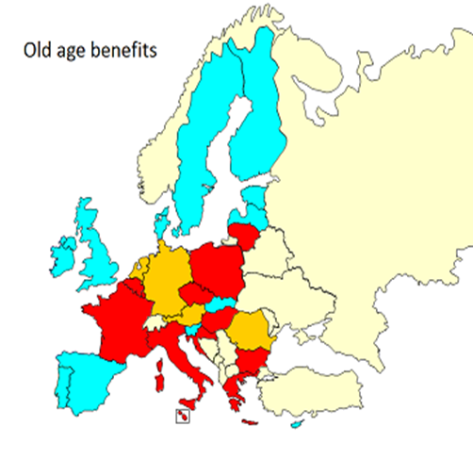
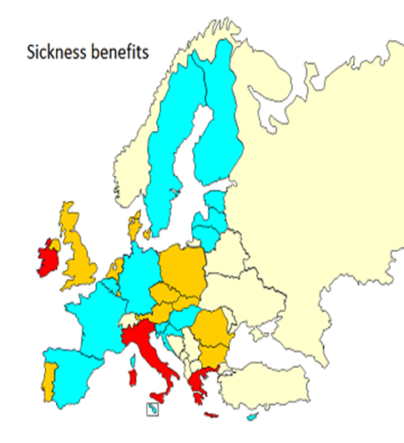
Is everyone having access to social protection?
The case of non-standard workers
The case of the self-employed
Notes:
Social protection systems, designed in the post-war area and still geared towards workers in full-time, open-ended contract, do not fully play their insurance role. In particular, the insurance mechanism is not yet accessible to segments of the labour market (self-employed, some forms of non-standard workers) as demonstrated in the IA accompanying the proposal for a Recommendation on Access to social protection. The prospects are that these groups will increase, diminishing the resources collected via social contributions, weakening the insurance function and underlining the need for stronger safety nets.
The mapping shows that the self-employed do not have any access to unemployment benefits in 11 Member States. They are not covered by sickness benefits in 3.

Slide 7
Is everyone being effectively covered?
Qualifications and contributions periods
Waiting periods
Calculation and duration of benefits

Slide 8
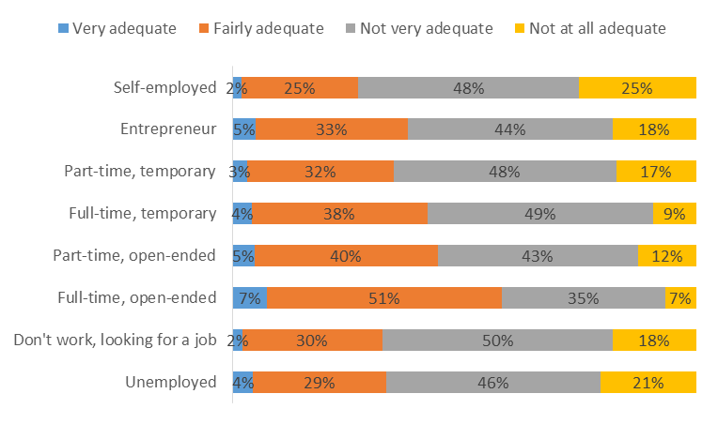
Do people feel protected? Perceptions on social protection by employment status
Source: Survey undertaken by Open Evidence (2018) for the European Commission

Slide 9
What are the benefits of improving protection?
Individual Level
Labour market and macroeconomic level
Sustainability of social security systems
Lowering the risk of individualisation of risk
Reducing income uncertainty
Reducing precariousness and poverty
Improving labour market dynamism and efficiency of factor allocation
Improving social security systems' ability to dampen economic cycles
Reversing the trend of a growing share of people outside systems narrowing financing base

Slide 10
Council Recommendation on Access to social protection: a political agreement
Material scope
Sickness and healthcare benefits
Maternity benefits
Unemployment benefits
Old-age benefits
Benefits in respect of accident at works and occupational injuries
Invalidity benefits
Personal scope
All workers
The self-employed
Notes:
Recap of the scope (if neede)

Slide 11
Council Recommendation on Access to social protection: a political agreement
Formal Coverage
Workers on a mandatory basis for all branches
Effective coverage
Rules governing entitlements and contributions
Entitlements to be preserved, accumulated or transferred
Adequacy
Sufficient and timely benefits
Proportionate contributions and exemptions to be applied regardless of status
Self-employed at least on a voluntary basis and where appropriate on a mandatory basis
Transparency
General and individual information
Simplification

Slide 12
Thanks for your attention

