Slide 1
Are all non-standard types of work precarious?
Franz Ferdinand Eiffe, Research Officer, Unit A Working Life
5 March 2019

Slide 2
Precarious employment
… can be defined as the intersection of three characteristics
Insecure employment
(e.g. fixed-term, tempory agency work)
Unsupportive entitlements
(i.e. few entitlements to income support when unemployed)
Vulnerable employees
Protective gaps include gaps in employment rights, social protection, representation and enforcment of rights

Slide 3
Policy context (selection)
Directives around labour law (1997, 1999, 2006, 2008, 2019)
Part-time Work, Fixed-term Work, Equal treatment, Temp. Agency Work, Predictable and transparent working conditions)
Lisbon strategy 2000
“the most competitive dynamic knowledge-based economy in the world capable of sustainable economic growth with more and better jobs and greater social cohesion”.
Europe 2020
“emphasises smart, sustainable and inclusive growth as a way to overcome the structural weaknesses in Europe's economy, improve its competitiveness and productivity and underpin a sustainable social market economy”
European Pillar of Social Rights
Principle 5: Secure and adaptable employment (regardless of the type and duration of the employment relationship)

Slide 4
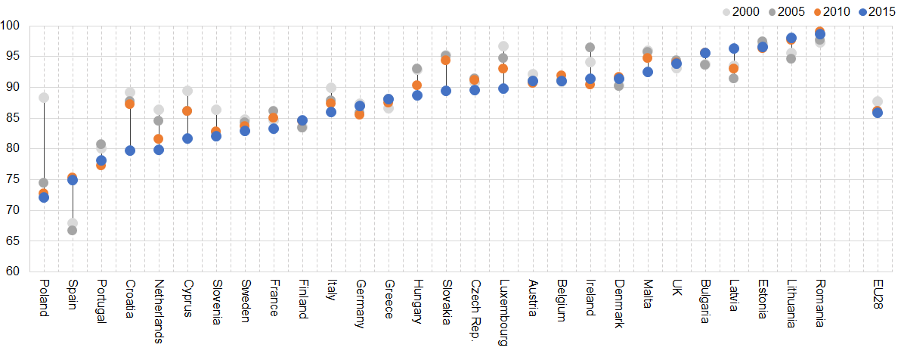
Little change on EU level / massive movements in some Member States
Indefinite employment in the EU as percentage of total dependent employment (2000-2015)
Source: LFS, Eurostat

Slide 5
Non-standard forms are more common in lower income groups

Slide 6
Low autonomy / access to training for fixed-term employees
Scale: 0 (low) – 100 (high)
Source: EWCS 2015, Eurofound

Slide 7
Poor prospects for fixed-term employees (< 1 year)
Scale: 0 (low) – 100 (high)
Source: EWCS 2015, Eurofound

Slide 8
Poor social environments for Solo Self-emp.
Scale: 0 (low) – 100 (high)
Source: EWCS 2015, Eurofound

Slide 9
Fixed-term (< 1 year): 3x disadvantaged
Red: negative association of employment status and JQ dimension; Blue: positive association between employment status and Job Quality dimension
Controls: gender, age, economic sector, occupation, and others
Source: EWCS 2015, Eurofound

Slide 10
Involuntary part-timers fare worse in most Job Quality dimensions than voluntary part-timers
Source: EWCS 2015, Eurofound

Slide 11
Conclusions
Precarious work (extended definition)
Multiple factors (selection):
Job insecurity / poor employment prospects
Low income / income insecurity
Protection gaps
High job strain (low autonomy / high intensity)
Limited access to fringe benefits
Social isolation at work
Types of workers at risk
Employees on fixed-term contracts (part. < 1 year)
Solo self-employed (part. economically dependent)
Involuntary part-time workers
EU Level Directives and Regulations
Empirically not yet fully affective as drawbacks / discrimination of non-standard workers are still identified in the data

Slide 12
Policy Responses
Advocate job quality in future EU strategies
Ensure equal treatment
Combatting abuses
Close the social protection gap
Support the self-employed
Promote collective representation

Slide 13
Background slides

Slide 14
Policy relevance
As Eurofound (2017; 2002a) indicated, the employment status makes a difference to working conditions and job quality.
Inequalities in job quality among and within different employment statuses are a significant policy concern.
The development of new and more flexible non-standard forms of employment go hand and hand with lower social protection and welfare benefits indicating shifts of risks from employers/states to workers
Policy makers have hence good reasons to intervene addressing certain forms of employment proved to be structurally associated with less-favourable job quality potentially leading to highly segmented labour markets

Slide 15
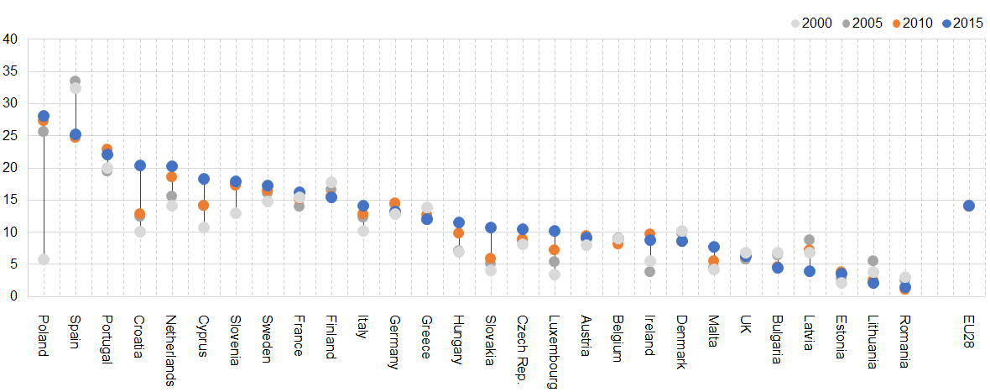
Developments
Temporary employment in the EU as percentage of total dependent employment (2000-2015)
Source: LFS, Eurostat

Slide 16
High work intensity for fixed-term employees
Scale: 0 (low) – 100 (high)
Source: EWCS 2015, Eurofound

Slide 17
Controlling for potential confounders
Red: negative association of employment status and JQ dimension; Green: positive association between employment status and JQ dimension (reversed for work intensity)
Controls: gender, age, economic sector, occupation, and others
Source: EWCS 2015, Eurofound

Slide 18
Controlling for potential confounders
Red: negative association of employment status and JQ dimension; Green: positive association between employment status and JQ dimension (reversed for work intensity)
Controls: gender, age, economic sector, occupation, and others
Source: EWCS 2015, Eurofound

Slide 19
Controlling for potential confounders
Red: negative association of employment status and JQ dimension; Green: positive association between employment status and JQ dimension (reversed for work intensity)
Controls: gender, age, economic sector, occupation, and others
Source: EWCS 2015, Eurofound

